Slide 1
Find a good place to open a Chinese restaurant in Toronto
Applied Data Science Capstone
IBM Data Science Professional Certification
Zhiao He

Slide 2
Problem
While opening a restaurant can be a very lucrative business, a lack of demand causes many restaurants to close within the first year of opening
Factors for Restaurant’s Success: Location, Competition, Quality of Food
Business Problem: If the client wanted to open a Chinese Restaurant in Toronto, what areas are the best options to open the restaurant?

Slide 3
Data
Data Sources:
Foursquare API
Toronto Census
Population & Ethnic Distribution of Each Neighborhood (Toronto Census)
Income Distribution of Each Neighborhood (Toronto Census)
Number of Restaurants in Each Neighborhood (Foursquare API)
Number of Indian Restaurants in Each Neighborhood (Foursquare API)
Latitude and Longitude of Each Neighborhood

Slide 4
Problem

Slide 5
Foursqaure API
Cluster 0 = Red Cluster 1 = Purple Cluster 2 = Blue Cluster 3 = Turquoise Cluster 4 = Orange

Slide 6
Cluster | Characteristics
Cluster 0 | Positive Spending Power (0.3 – 1.8)
Cluster 1 | Negative Spending Power (-1.2 -- -0.8)
Cluster 2 | Near Zero Spending Power (-0.5 – 0.5)
Cluster 3 | High Positive Spending Power (1.7+)
Cluster 4 | Negative Spending Power (-0.8 – 0) With Large Number of Restaurants

Slide 7
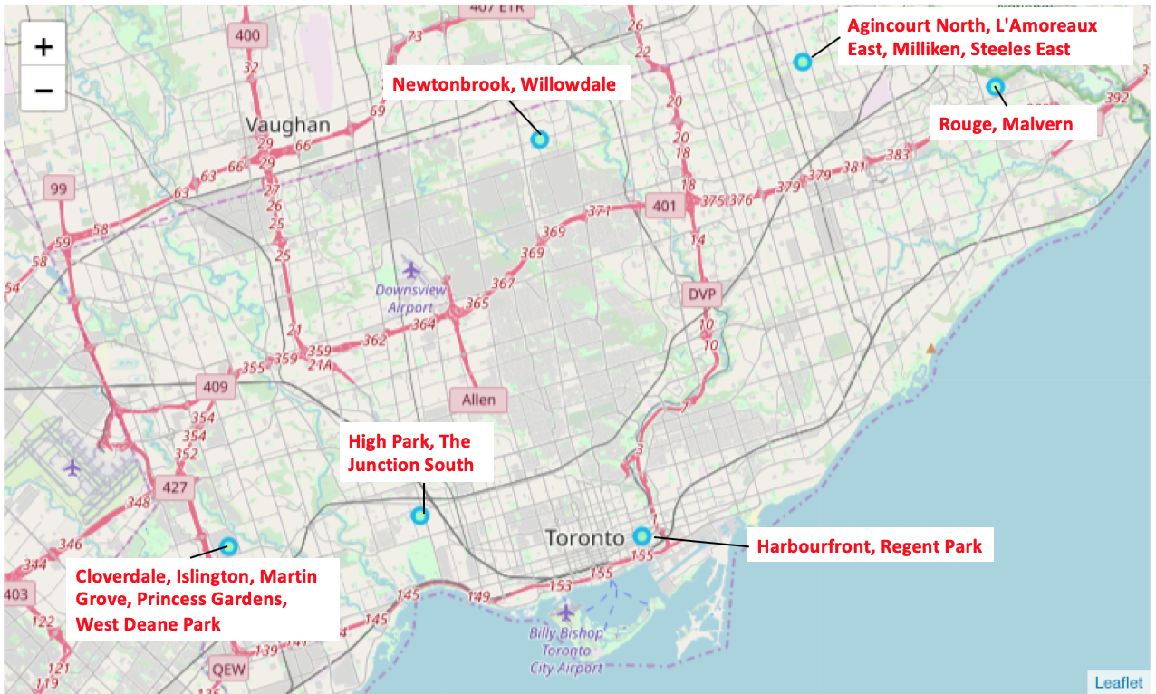

Slide 8
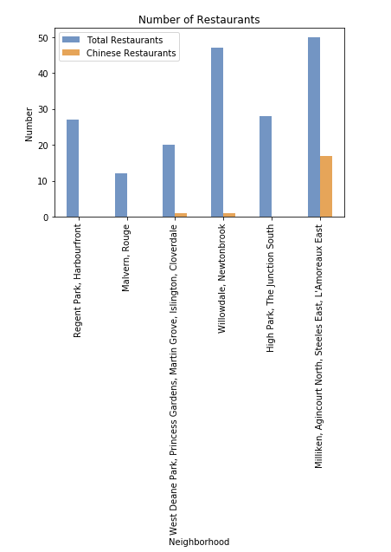
From the plot, the following areas can be eliminated due to the large number of restaurant:
Willowdale,Newtonbrook
Milliken, Agincount North, Steeles East, L’Amoreaux East

Slide 9
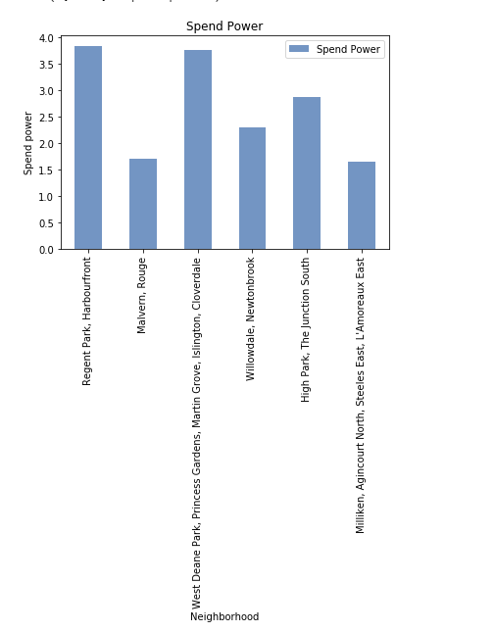
We can find that Regent Park, Harbourfront, West Deane, Princess Gardens, Martin Grove, Islington, Clovedale have higher spend power

Slide 10
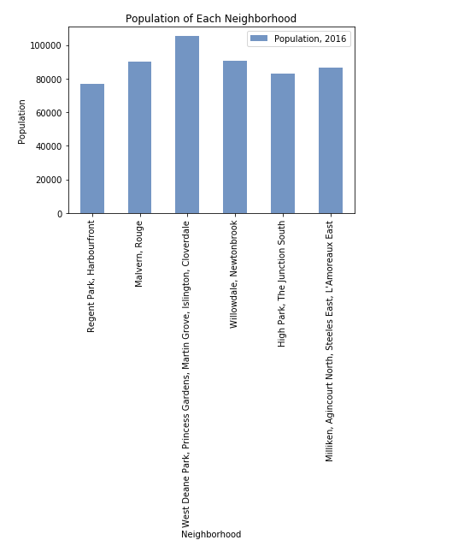
West Deane Park, Princess Gardens, Martin Grove, Islington, Cloverdale have the largest population

Slide 11
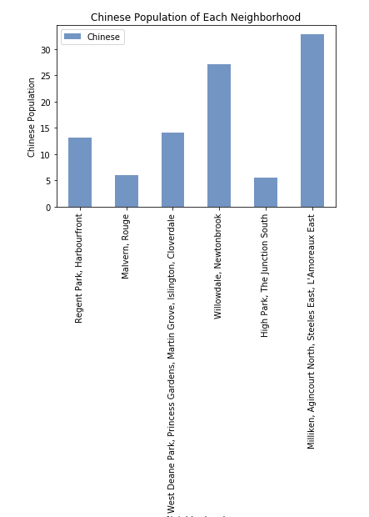
Chinese Population distribution

Slide 12
Conclusion
The best location to open a Chinese restaurant in Toronto, Canada would be the Willowdale ,Newtonbrook area.

Slide 13
Thank you!

